Slide 1




Spring Presentation
Class of 2025

Slide 2

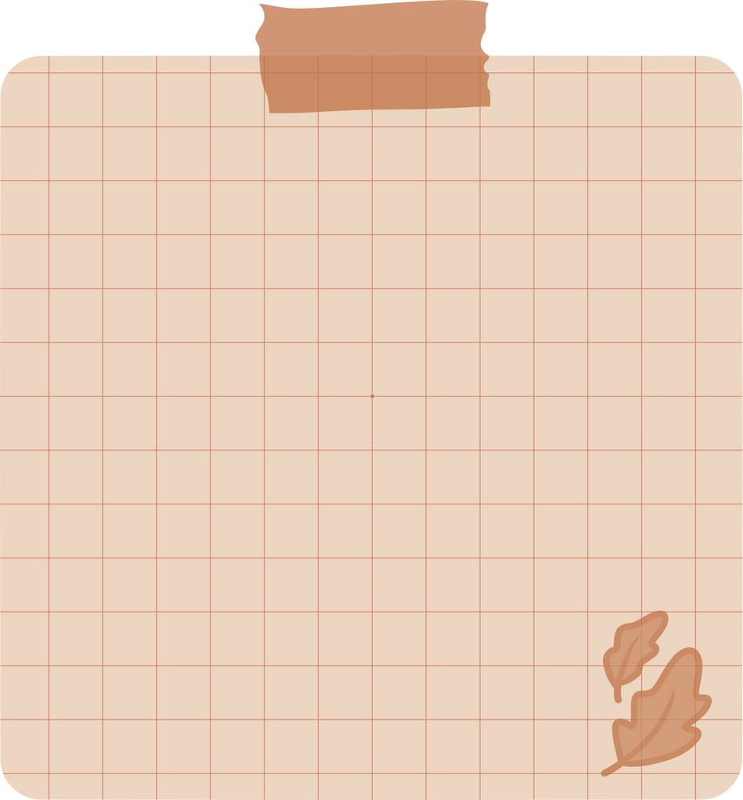

Checklist
  Credits Completed
  Community Service
  Discipline Cleared
  FAFSA/CADAA
  Parchment
  Post-Secondary Plan
  Resume Support
  Senior Survey
  Graduation
Are you ready
to graduate?

Slide 3
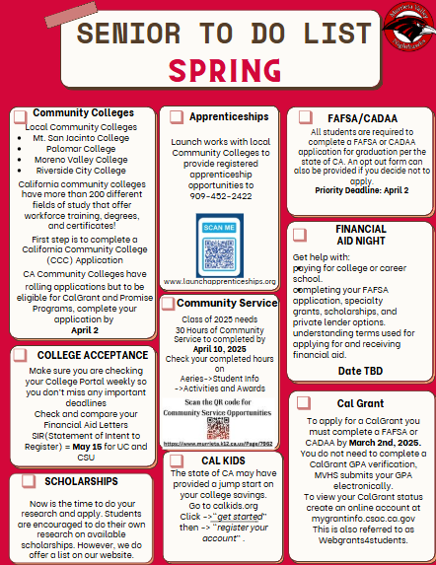
  Launch your CCC
(California Community College) Application through CaliforniaColleges.edu
3. Complete your FAFSA/CADAA
by April 2, 2025
2. Be sure to check your College Portal for Deadlines and Financial Aid Letters
4. 30 Hours of Community Service is due by
April 10, 2025

Slide 4

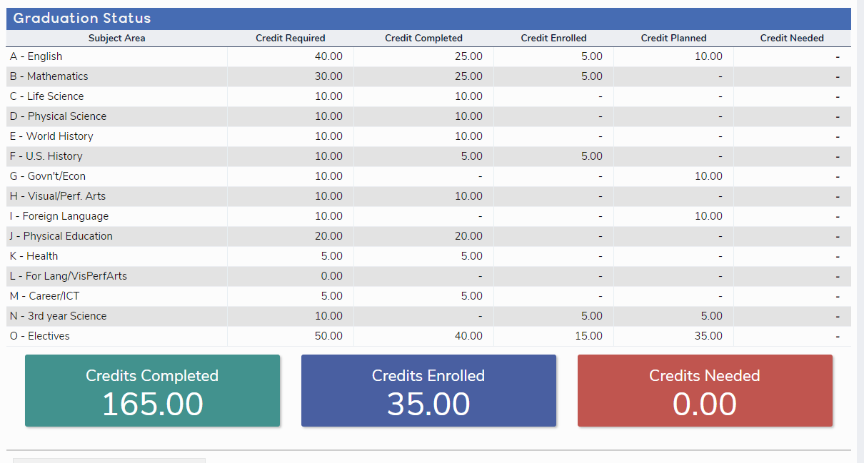

GRADUATION STATUS
Check in AERIES, Graduation Status
HAVE YOU COMPLETED YOUR CREDIT RECOVERY?

Slide 5
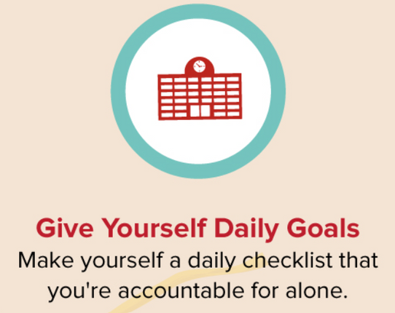
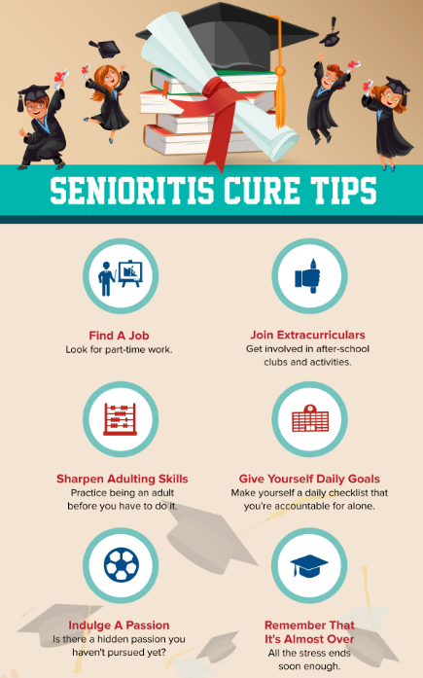


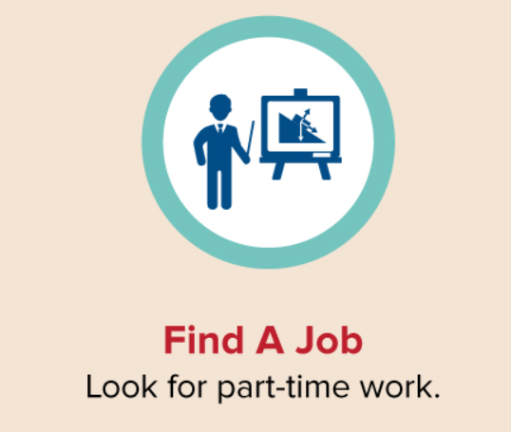


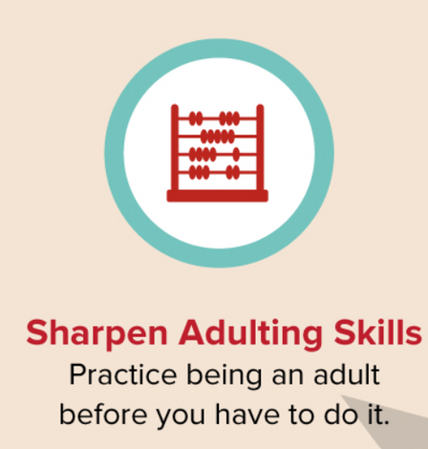

Slide 6
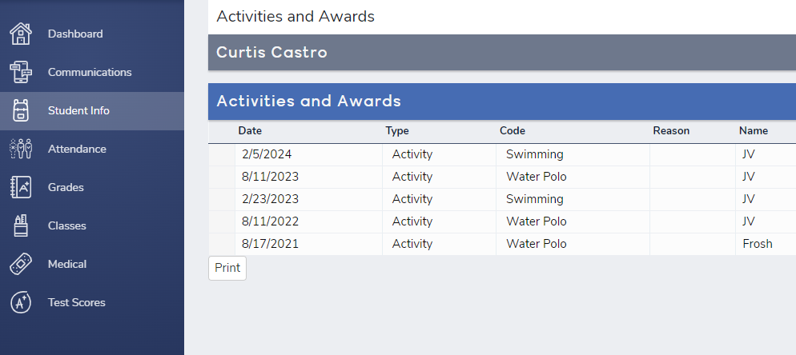
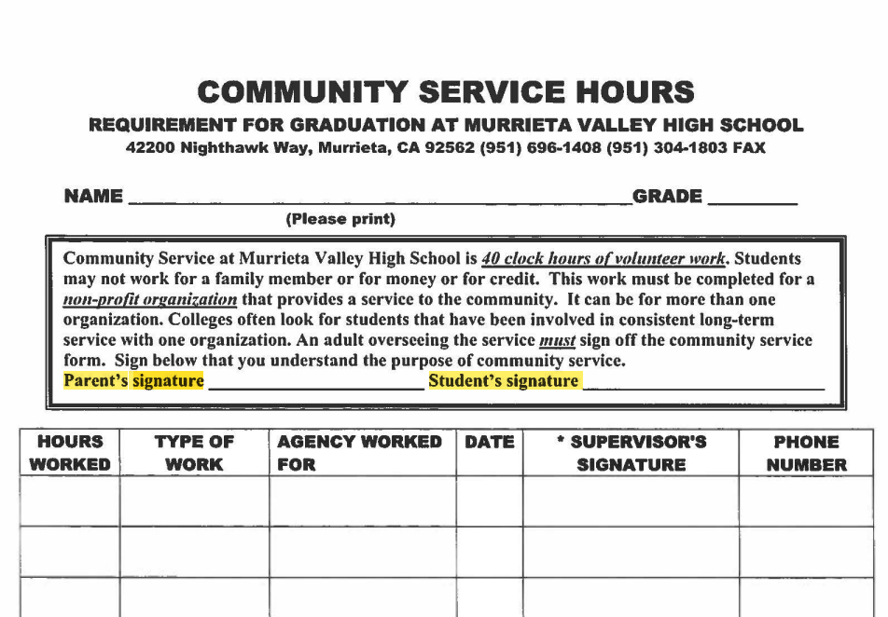
COMMUNITY SERVICE
Check in AERIES
30 hours

Slide 7

DISCIPLINE
DISCIPLINE
CHECK WITH
Mrs. Lynton in
STUDENT SUPPORT
YOU MUST CLEAR THEM

Slide 8
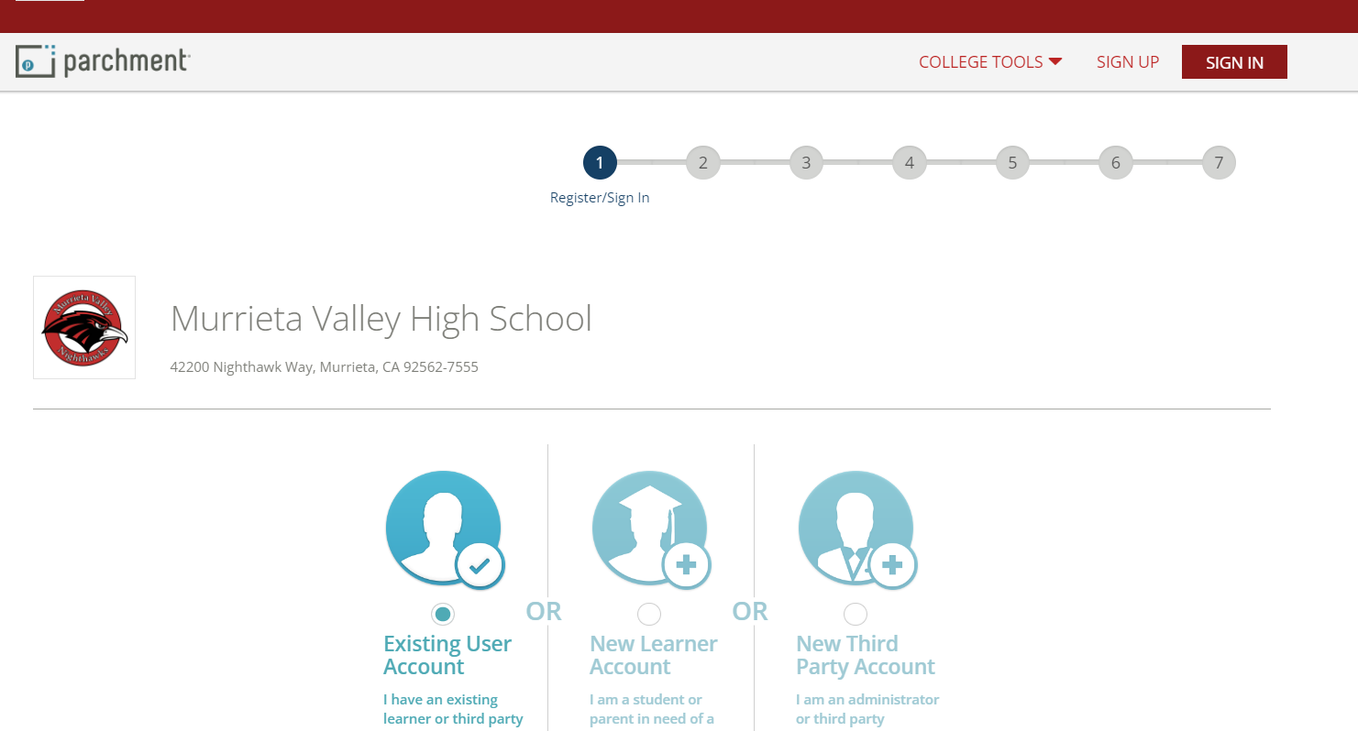
PARCHMENT
  USE PERSONAL EMAIL
  Chose option to order and “wait until grades finalize”
TRANSCRIPT

Slide 9
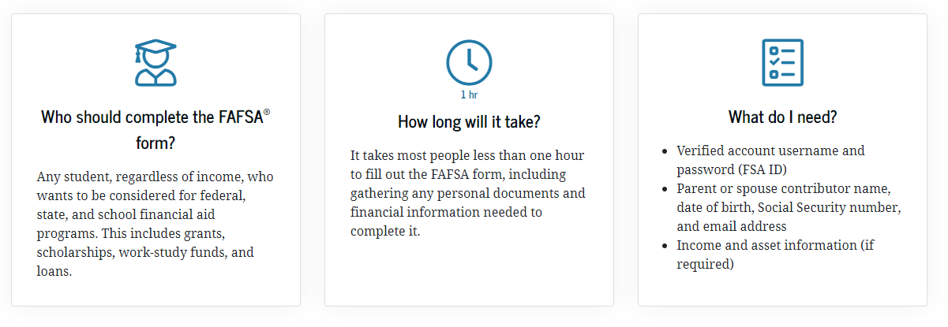
FAFSA/CADAA
ALL students need to complete a FAFSA/CADAA for Senior Check Out
$$$

Slide 10







What is your Plan?
BOOK AN APPOINTMENT WITH YOUR COUNSELOR
https://www.murrieta.k12.ca.us/domain/1433

Slide 11
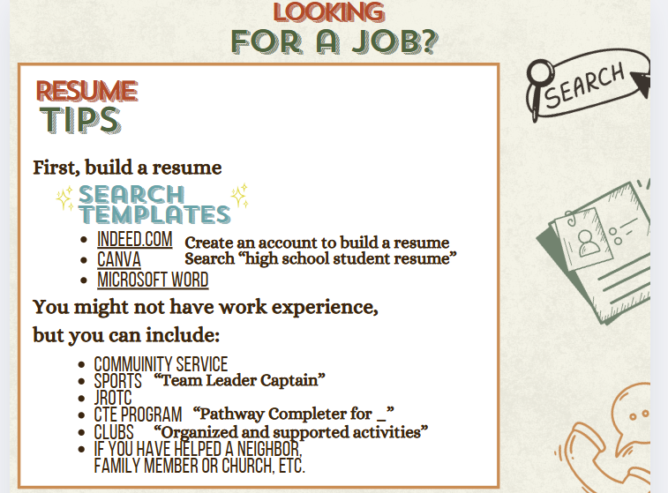

Resume

Slide 12

Resume

Slide 13

June 4: Mandatory Graduation Practice 1-3 PM
June 5: Graduation at 6 PM

Slide 14





Questions?

